Slide 1



Mission Strike OBJ RIGEL
Flightbrief

Slide 2
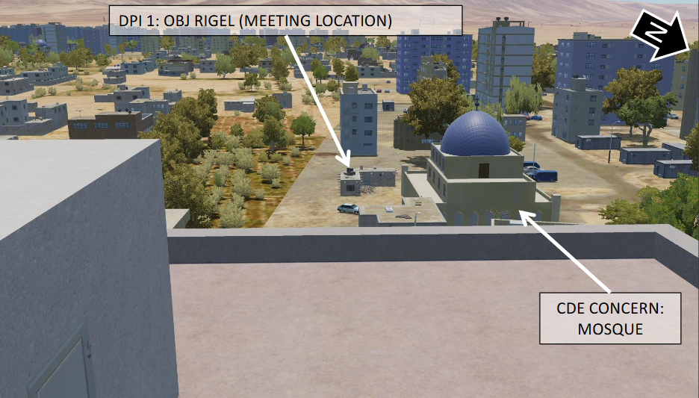
MISSION
Mission:
Strike OBJ RIGEL (HVT location)
Participants:
CHEVY
ARCO
OVERLORD

Slide 3
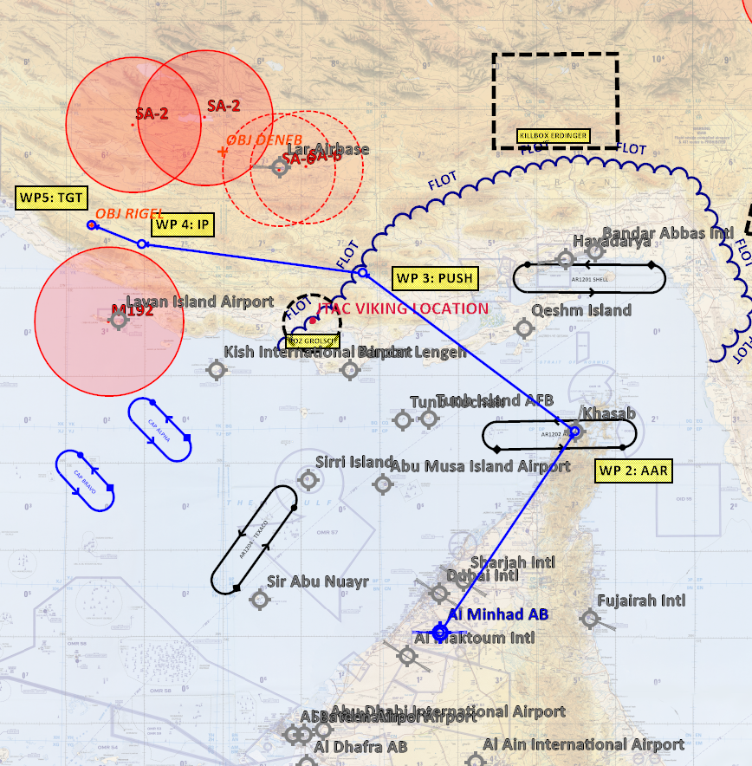
FRIENDLY SITUATION
JEDI: SEAD
RAGE
ANGRY
STRIKE/SEAD
VIPER: Strike
CAS
CLAW/AXE/COBRA
SPECTRE
PANTHER
CAP

Slide 4
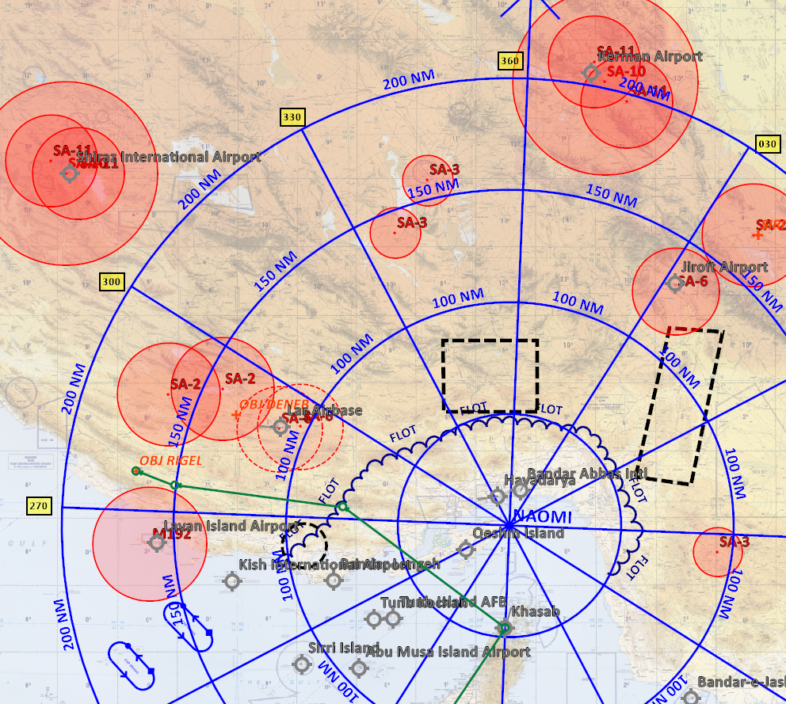
ENEMY SITUATION

Slide 5
THREATS

Slide 6
FLIGHTPLAN

Slide 7
FLIGHT ADMIN
Flight Info:
Rollcall: CHEVY 3-1 / CHEVY 3-2
Internal frequency: MDC
Intra-flight TACAN frequency:MDC
IFF:MDC
Datalink settings:
Loadout: MDC
Lasercodes: MDC
Briefing time:
Pit time (Step time): 1815Z
Check-in time:1820Z
Expected taxi time:1835Z
Expected take-off time: 1839Z
Weather data:
Airfield: Clear skies, calm winds from EAST
Target area:
Departure
Type of takeoff: 20 sec trail
Rejoin procedures and formation: Echelon
Join up formation:
Expected systems / OPS check:
Aborted take-off procedure:
Emergency after take-off procedure:

Slide 8
FLIGHT ADMIN
Enroute
Bullseye: NAOMI
Altitude: FL200
Formation: Line abreast (A-A, until check-in A-G, before IP)
Push times: 1917Z (passing FLOT)
Details of all agencies that are to be interacted with:
ATC: Unmanned
DARKSTAR: Check-in
OVERLORD: A-G
Any requirements for radio silent / EMCON procedures:
Radio failure procedures and contingencies:
SOP
Fuel Management
Bingo: 3500
Joker:3500
Fuel awareness: Reports tanks dry
Afterburner use and restrictions: Takeoff/combat (not rejoin)
Considerations:
Tanking
Tanker Callsign: ARCO
Track/anchor:AR1202
Altitudes:FL190
Times: 1850Z-1905Z
Onload:Full
Night/IMC/Breakaway:
Reform:
Contingencies:
RTB
Rejoin formation: Echelon
Operational checks:
Battle Damage Assessment:
Expected recovery type: OHB
Alternate field ( TACAN / ILS / FREQ): Al Dahfra , See MDC

Slide 9
BULLSEYE

Slide 10
CONTRACTS
Rejoin Finger 4, #2 Left
Climb: 350 Kts
Cruise 350 Kts
Combat 450 Kts
A-G (Ingress)
(Low-level): Wedge/fighting wing
A-A (Egress)
Line Abreast: 0.5-1nm. #2 1000ft high
Radar:
#1 High and far
#2 Low and near
Sorting:
#1 : Left, Lead, High
#2: Right, Trail, Low
4 Assumptions:
Visual: meaning they have sight of the other friendly fighter
No Joy: meaning they do not have a tally on any unknown or hostile aircraft
Naked: No RWR indication (opposite of “Spike”, “Nails”, “Mud”, “Dirt”)
Clean: meaning the fighter has no radar contacts
#2 report if this changes and it have not been picked up by lead.
40
Commit
35
Tactical /target range
30
Meld and Sort
25
Shoot: FOX 3 , Crank
20
Assess targeted status
15
NLT Abort
8
NLT Defend
Merge

Slide 11
A-G
Confirm HVT:
Convoy 4 vehicles
High security
LGB , self lased
2x GBU12 (1 each in case miss/failure)
Attack from line abreast
In-out as fast as possible

Slide 12
QUESTIONS

